Slide 1

Solving College Math Problems using Large Language Models
This presentation explores the potential of large language models (LLMs) to revolutionize the way we solve college-level math problems, specifically focusing on Fourier series.
Presented By : Subrat Setha

Slide 2
Introduction to Fourier Series
Periodic Functions
Applications
Fourier series represent periodic functions as a sum of sine and cosine waves.
They have widespread applications in fields like signal processing, heat transfer, and acoustics.

Slide 3
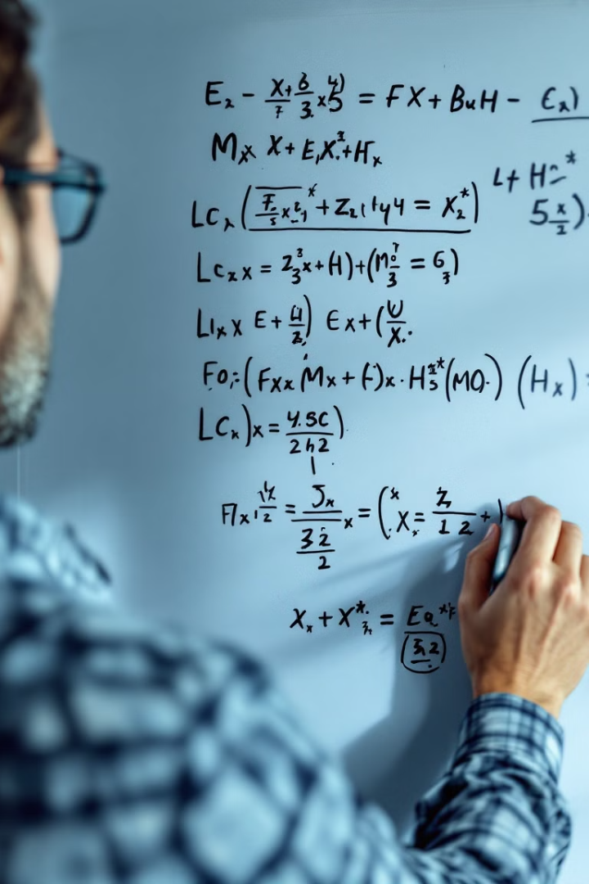
Limitations of Traditional Approaches
Time Consuming
Error-Prone
Traditional methods can be tedious and require significant time and effort.
Manual calculations are prone to errors, especially with complex functions.
Lack of Insight
Traditional methods often fail to provide deeper understanding of the underlying concepts.

Slide 4




How LLMs can Assist with Fourier Series
Symbolic Manipulation
Data Analysis
LLMs can efficiently manipulate mathematical expressions and solve complex equations.
They can analyze data and extract patterns for predicting the behavior of functions.
Visualization
LLMs can visualize complex functions, aiding in understanding their properties.

Slide 5



Leveraging Pretrained LLM Features for Math
Textual Reasoning
1
LLMs excel at understanding and processing natural language, which is crucial for interpreting mathematical problems.
Pattern Recognition
2
They have learned to identify patterns in vast amounts of data, enabling them to recognize mathematical relationships.
Code Generation
3
LLMs can generate code for symbolic manipulation and numerical computation, streamlining the problem-solving process.

Slide 6
Challenges in LLM-based Math Problem Solving
Accuracy
1
Ensuring the accuracy of LLM-generated solutions remains a significant challenge.
Explainability
2
Understanding how LLMs arrive at their solutions is essential for building trust and gaining insights.
Adaptability
3
LLMs need to adapt to different mathematical domains and problem types for wider applicability.

Slide 7
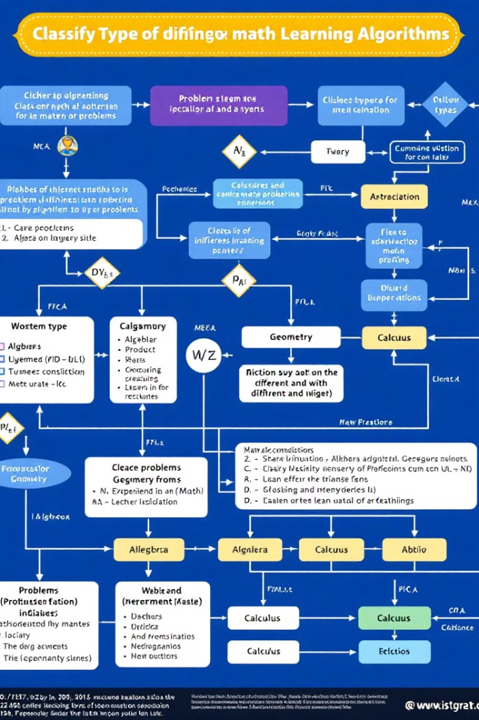
Categorizing Math Problems for LLM Optimization
Symbolic Algebra
Calculus
Problems involving manipulation of equations and expressions.
Problems involving derivatives, integrals, and limits.
Differential Equations
Problems involving equations that describe the relationships between functions and their derivatives.

Slide 8

Introducing the Self-Critique Pipeline
1
Problem Analysis
LLMs first analyze the problem to identify its type and relevant concepts.
2
Solution Generation
They then generate a solution based on their understanding of the problem.
3
Self-Evaluation
LLMs critically evaluate their solution, checking for logical errors and inconsistencies.
4
Refinement
If errors are detected, LLMs refine their solution based on their evaluation.

Slide 9

Improving LLM Math Capabilities
1
2
3
Data Augmentation
Hybrid Models
Interactive Learning
Feeding LLMs with larger and more diverse mathematical datasets.
Combining LLMs with traditional symbolic computation methods.
Enabling LLMs to learn from user feedback and corrections.

Slide 10

Conclusion and Future Directions
LLMs have the potential to revolutionize the way we approach college-level math problems. Continued research and development will lead to even more powerful and versatile solutions.

